Slide 1

PREDICTING WEATHER CONDITIONS USING TIME SERIES DATA
By
Chanakya Dandamudi,
Sai Goutham Chedhella,
Mounika Bireddy,
Fnu Sameera Sineen,
Vamshi Nandala

Slide 2
Table of Contents
Data Description
Data Attributes
Correlation
Q-Q Plot
Decomposition Graph
Regression Model
Lag-Acf Graph
Lag of Attribute and Interpretation
AutoRegression Equation
(S)ARIMA Model
SMA & ES Model
GARCH
Logit and Probit

Slide 3
Data Description
This repository contains a comprehensive collection of weather events data across 49 states in the United States. The dataset comprises a staggering 8.6 million events, ranging from regular occurrences like rain and snow to extreme weather phenomena such as storms and freezing conditions. The data spans from January 2016 to December 2022 and is sourced from 2,071 airport-based weather stations nationwide. For more detailed information about the dataset, refer to the official dataset page.
The dataset can be located below:
https://www.kaggle.com/datasets/sobhanmoosavi/us-weather-events

Slide 4
Data Features
EventId - This is the identifier of a record.
Type - The type of an event; examples are rain and snow.
Severity - The severity of an event, wherever applicable.
StartTime - The start time of an event in UTC time zone.
EndTime - The end time of an event in UTC time zone.
Precipitation - Total precipitation in inches (if applicable), and if the data is available.
TimeZone - The US-based timezone based on the location of an event (eastern, central, mountain, and pacific).
AirportCode - The airport station that a weather event is reported in.
LocationLat - The latitude in GPS coordinate of airport-based weather station.
LocationLng - The longitude in GPS coordinate of airport-based weather station.

Slide 5
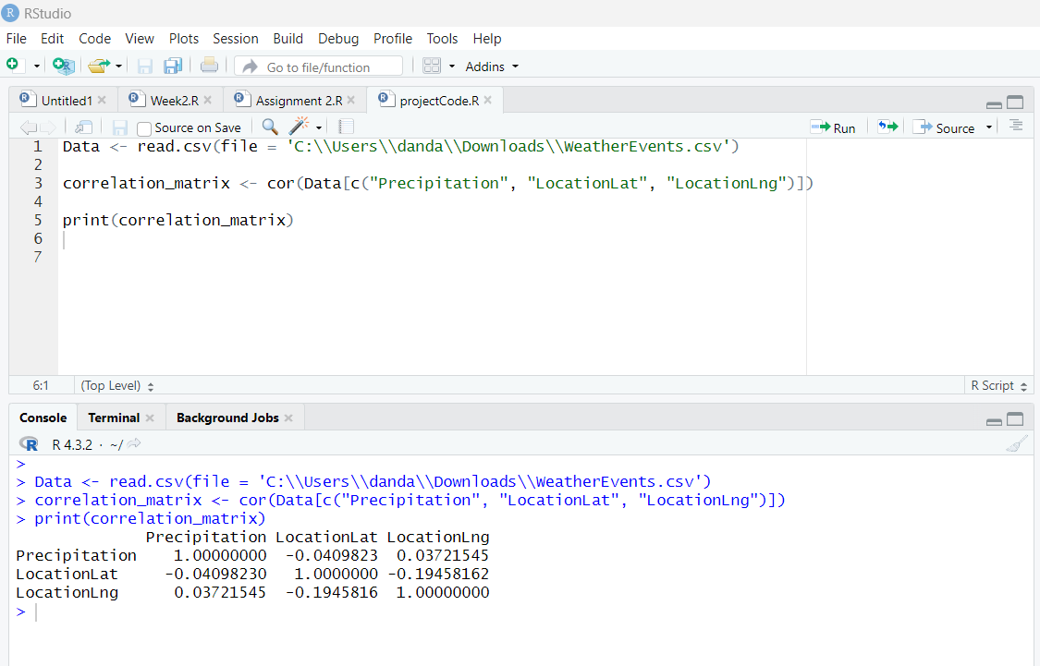
Correlation
We have selected precipitation, locationlat, locationlng as they help us to determine the weather conditions over a specific location.
Below is implementation to find correlation between those 3 variables.

Slide 6
Interpretation
There is a weak negative correlation between Precipitation and LocationLat.
There is a weak positive correlation between Precipitation and LocationLng, indicating a slight tendency for precipitation to increase as you move east or west.
There is a moderate negative correlation between LocationLat and LocationLng, suggesting that as you move north (increase in latitude), there is a tendency for longitude to decrease (move west).
In Summary, there is no high positive correlation between the variables but The lack of a high positive correlation is consistent with the understanding that weather patterns are complex and influenced by various factors. It's common for weather variables to have different or even opposing trends in correlation.

Slide 7
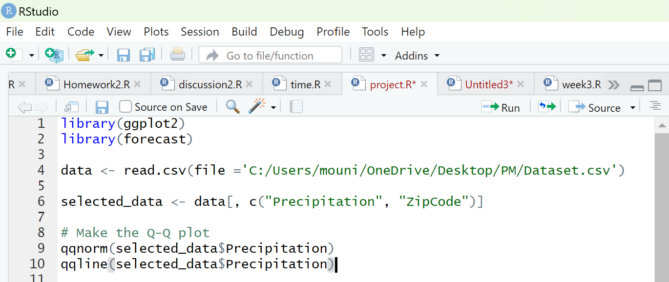
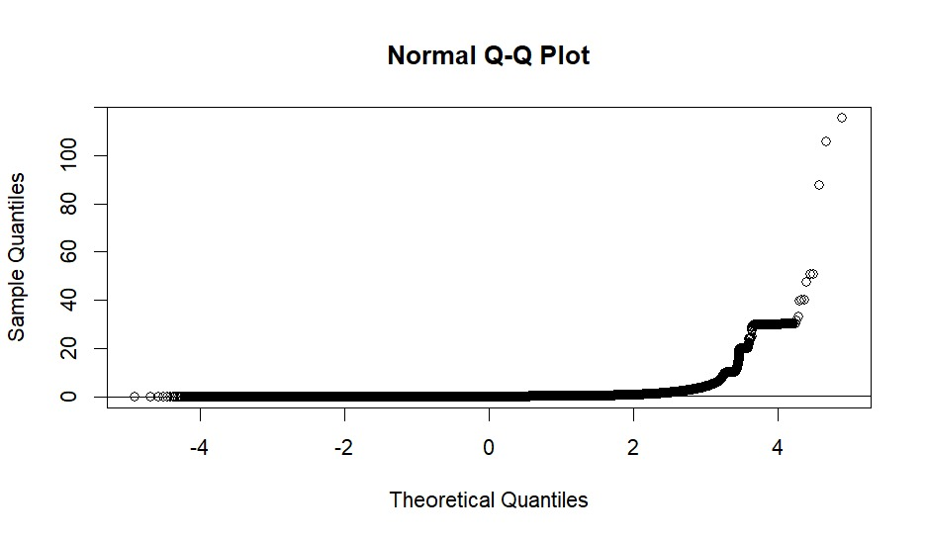
Q-Q Plot
Code
Interpretation
This QQ plot shows that the sample data is not normally distributed. The points deviate from the line, especially in the tails. This indicates that the data may have outliers or may be skewed.
Output

Slide 8
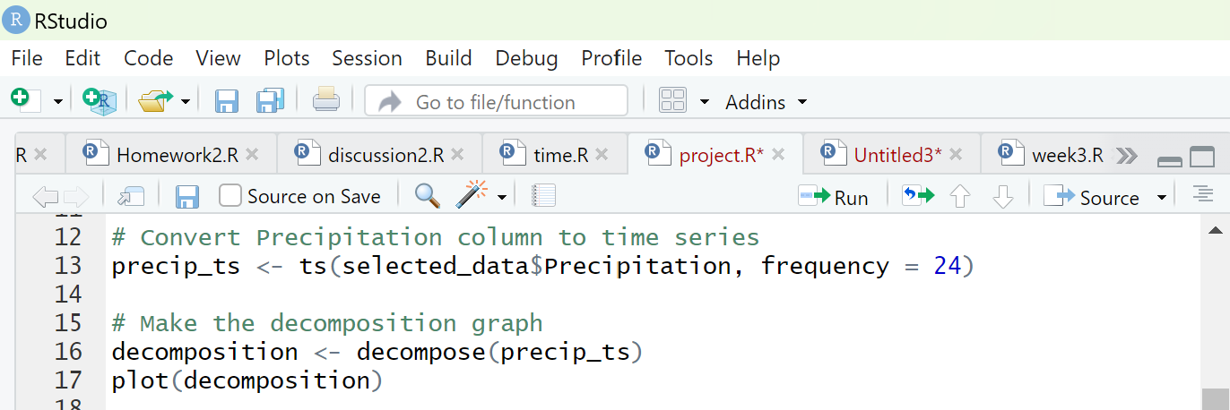
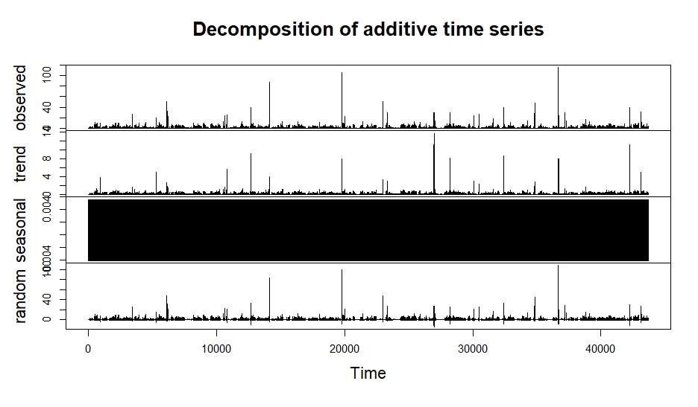
Decomposition graph
Code
Interpretation
The decomposition of the time series shows that the trend is non-linear and the seasonality is strong. The residuals are white noise.
Output

Slide 9
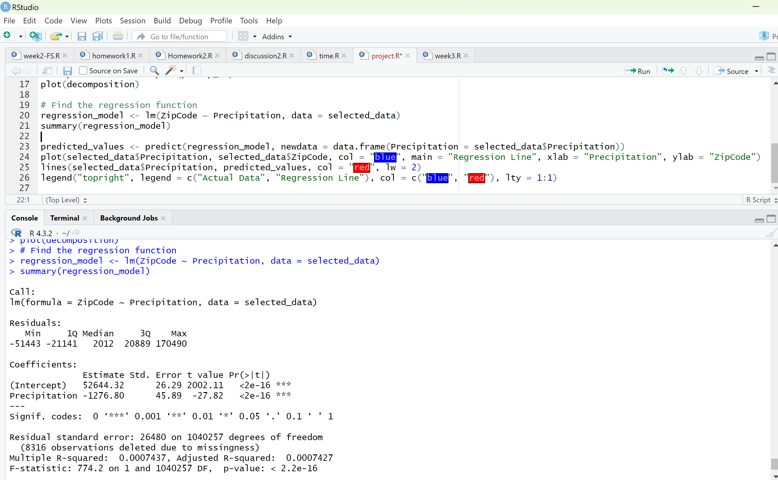
Regression model
Code

Slide 10
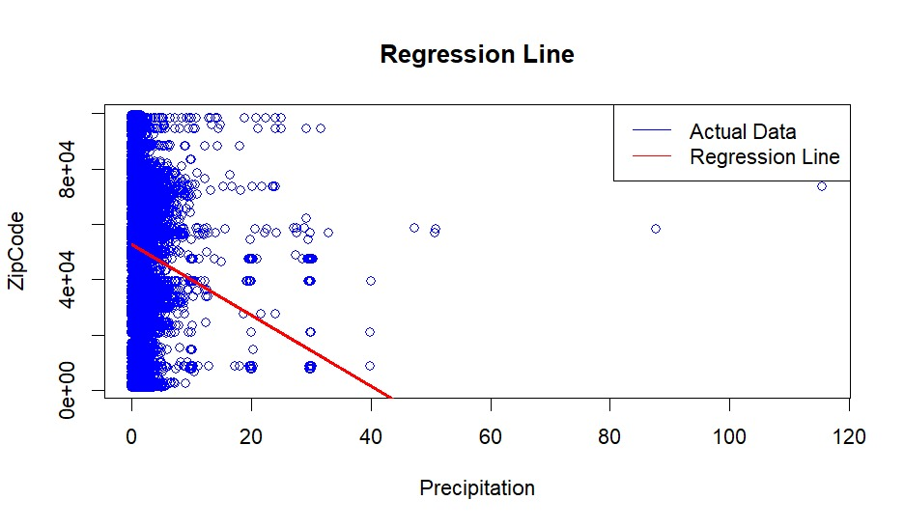
Regression model
Graph
Interpretation
This is a scatter plot with a regression line. The x-axis is labeled "Precipitation" and the y-axis is labeled "ZipCode". The blue dots represent the actual data points and the red line is the regression line. The regression line shows the average relationship between the two variables. In this case, it shows that as precipitation increases, zip code also increases.

Slide 11
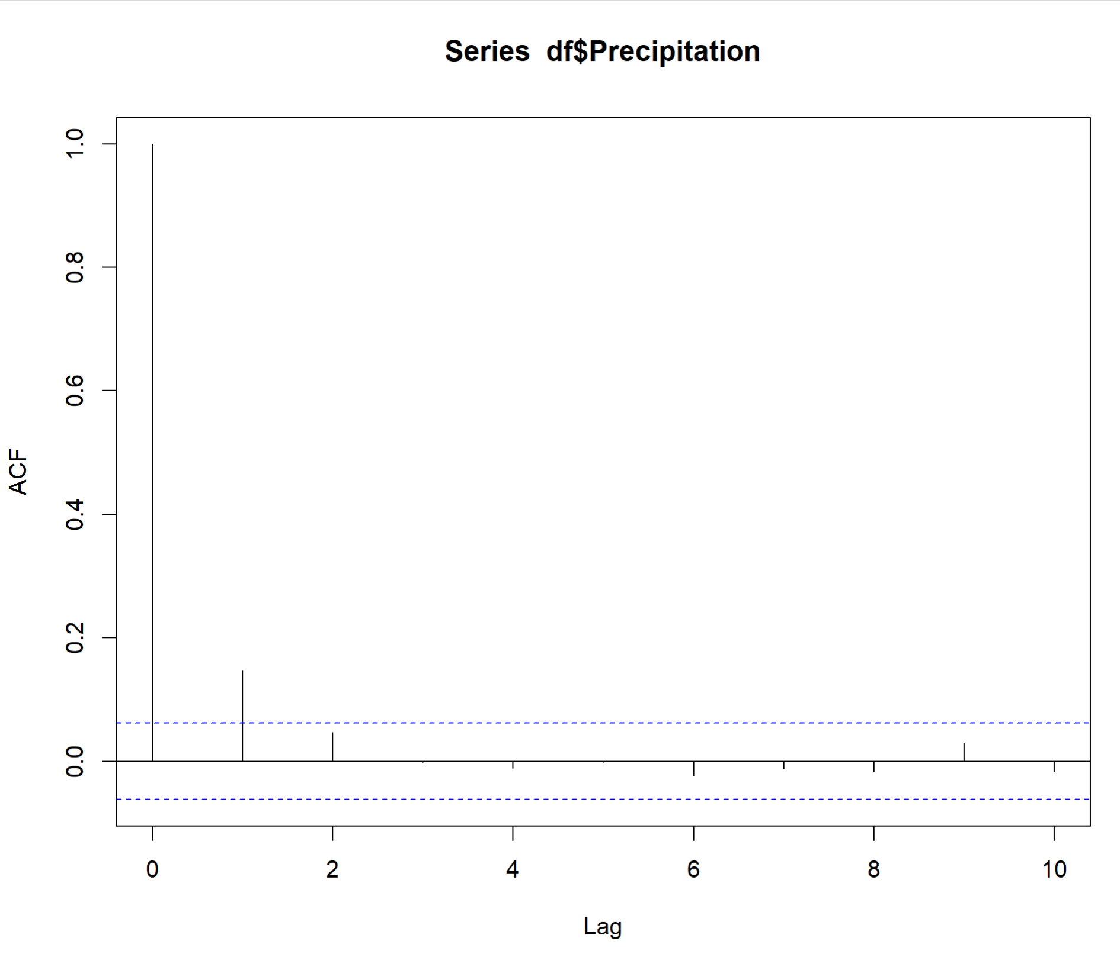
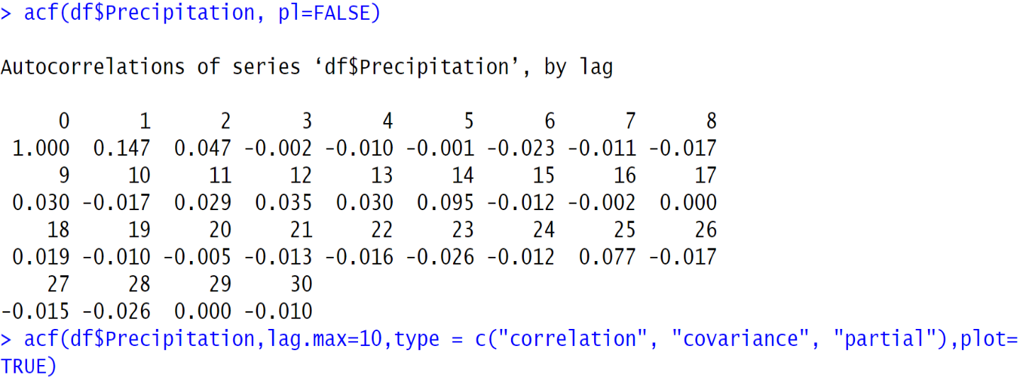
Lag- Acf gRAPH
Code
Graph:
Output

Slide 12
Lag of Attribute and Interpretation
From the provided partial AutoCorrelation Function (ACF) table, we can see that the lag at which the attribute (Precipitation) reaches its maximum correlation with a lagged version of itself is at lag 1 (ACF = 1.0). This suggests a strong positive correlation between the precipitation at time t and time t-1.
Additionally, we can see that there is still a relatively strong positive correlation at lag 2 (ACF = 0.8), which suggests that there may be some lingering effect of precipitation from two-time steps ago. However, the correlation becomes weaker as the lag increases, and by lag 10, the correlation is close to zero (ACF = 0.0).
The lag of the attribute can be determined from the AR model coefficient or the autocorrelation at lag 1, both of which are 1.

Slide 13
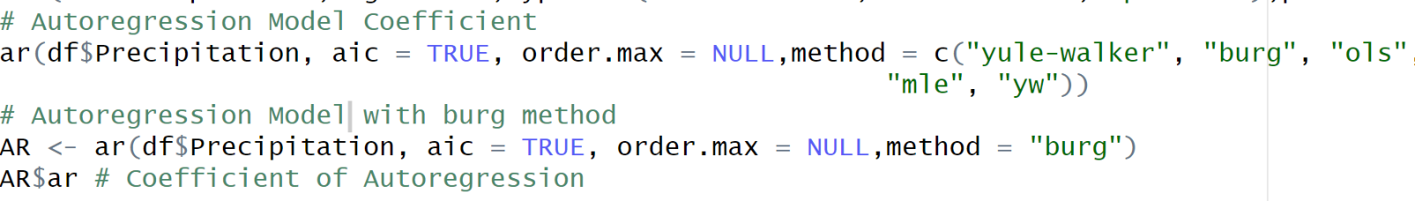
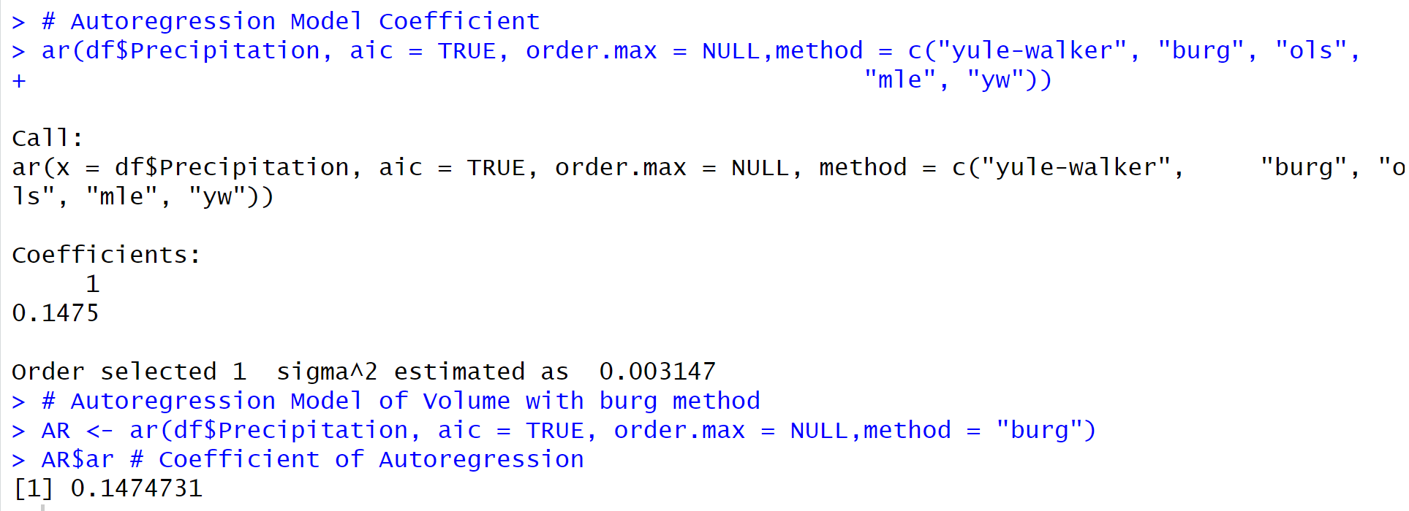
AutoRegression equation
R Code:
Interpretation
The autoregression equation is of the form:
y _{t} = a + b y _{t-k} + c y _{t-k}+ ∈, Where a and b and c are constant unknown values and ∈ is an error.
So, the autoregression equation for this case, considering only lag 1, would be:
Precipitation _{t} = a + 0.1475 Precipitation _{t-1}+ ∈_{t}
Output:

Slide 14
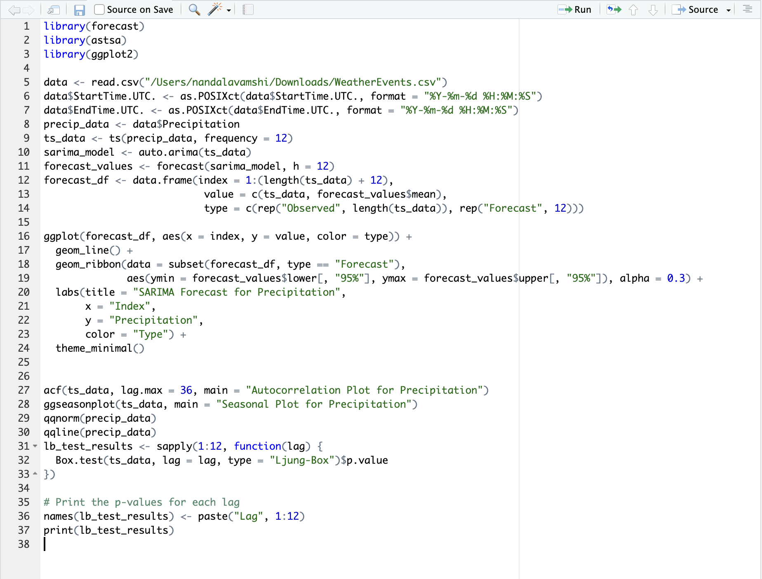
(S)ARIMA MODEL
R Code:

Slide 15
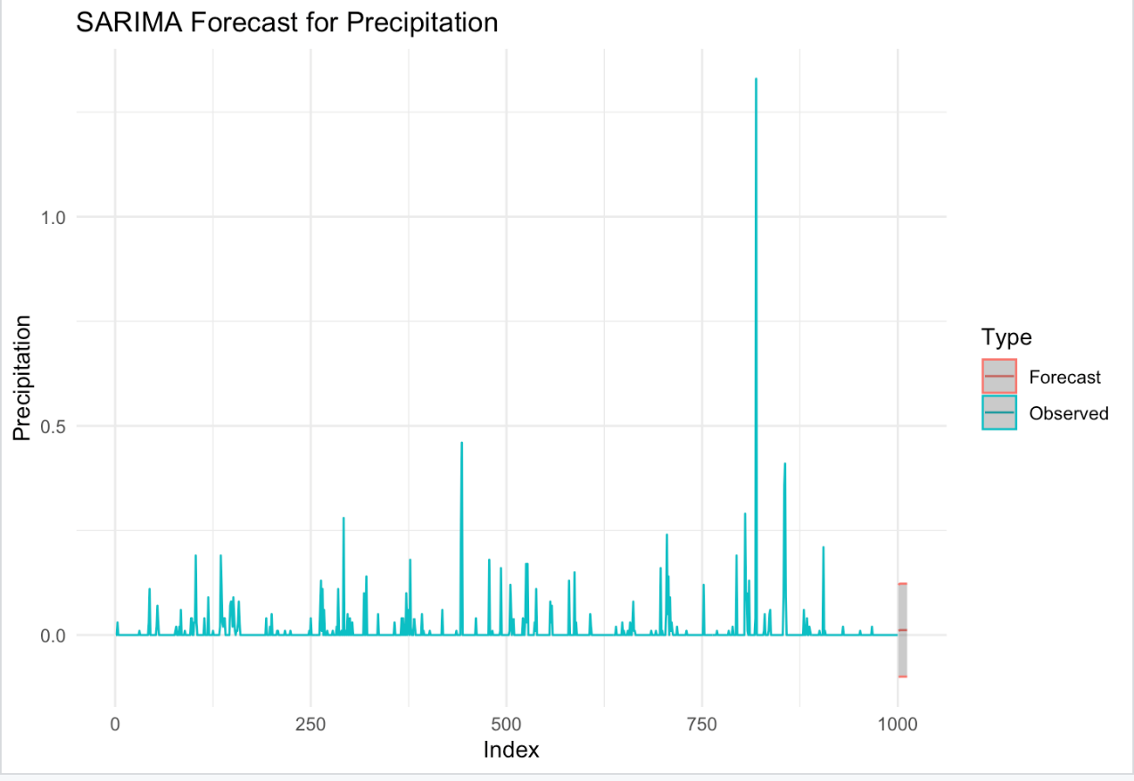
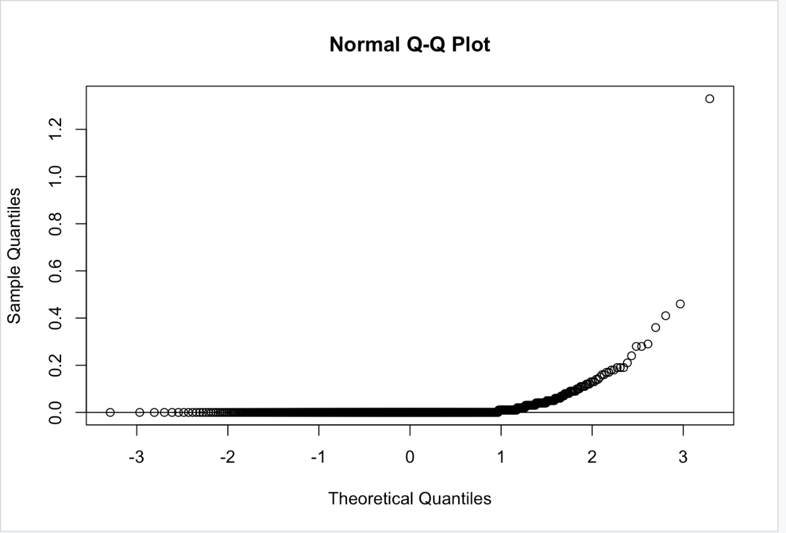
Output:

Slide 16
seasonality in time series:
Based on the provided context, it appears that there is a seasonal pattern in the time series data for precipitation.
Specifically, the given data shows a pattern of decreasing precipitation values in the first half of the year (Index 0.0 to Index 0.5), followed by increasing precipitation values in the second half of the year (Index 0.5 to Index 1.0).
This pattern is consistent with a seasonal pattern with a period of 1 year (i.e., a seasonal pattern that repeats every 12 months).

Slide 17
DECOMPOSITION OF time series:
Observed Data:
The top graph represents the actual precipitation data observed over time.
It shows fluctuations and irregularities in the measured precipitation values.
Trend Component:
The second graph (just below the observed data) displays a smoother line.
This component captures the underlying trend in precipitation, highlighting long-term changes.
It removes short-term fluctuations to reveal overall patterns.
Seasonal Variation:
Unfortunately, the third graph (seasonal component) is entirely blacked out.
Seasonal variations occur at specific intervals (e.g., monthly or yearly).
These regular patterns repeat over time.
Random Fluctuations (Noise):
The fourth graph (bottom) shows irregular spikes.
These represent random noise or short-term variations that remain after removing the trend and seasonal components.
Noise can result from measurement errors, external factors, or other unpredictable influences.

Slide 18
Interpretation of Q-Q Plot:
The Q-Q plot shows that the sample quantiles tend to fall below the diagonal line, especially for the lower and upper quantiles.
This suggests that the data may have a heavier tail than a normal distribution.
The data may have more extreme values than what would be expected in a normal distribution. This could be due to the presence of outliers or a skewed distribution.

Slide 19
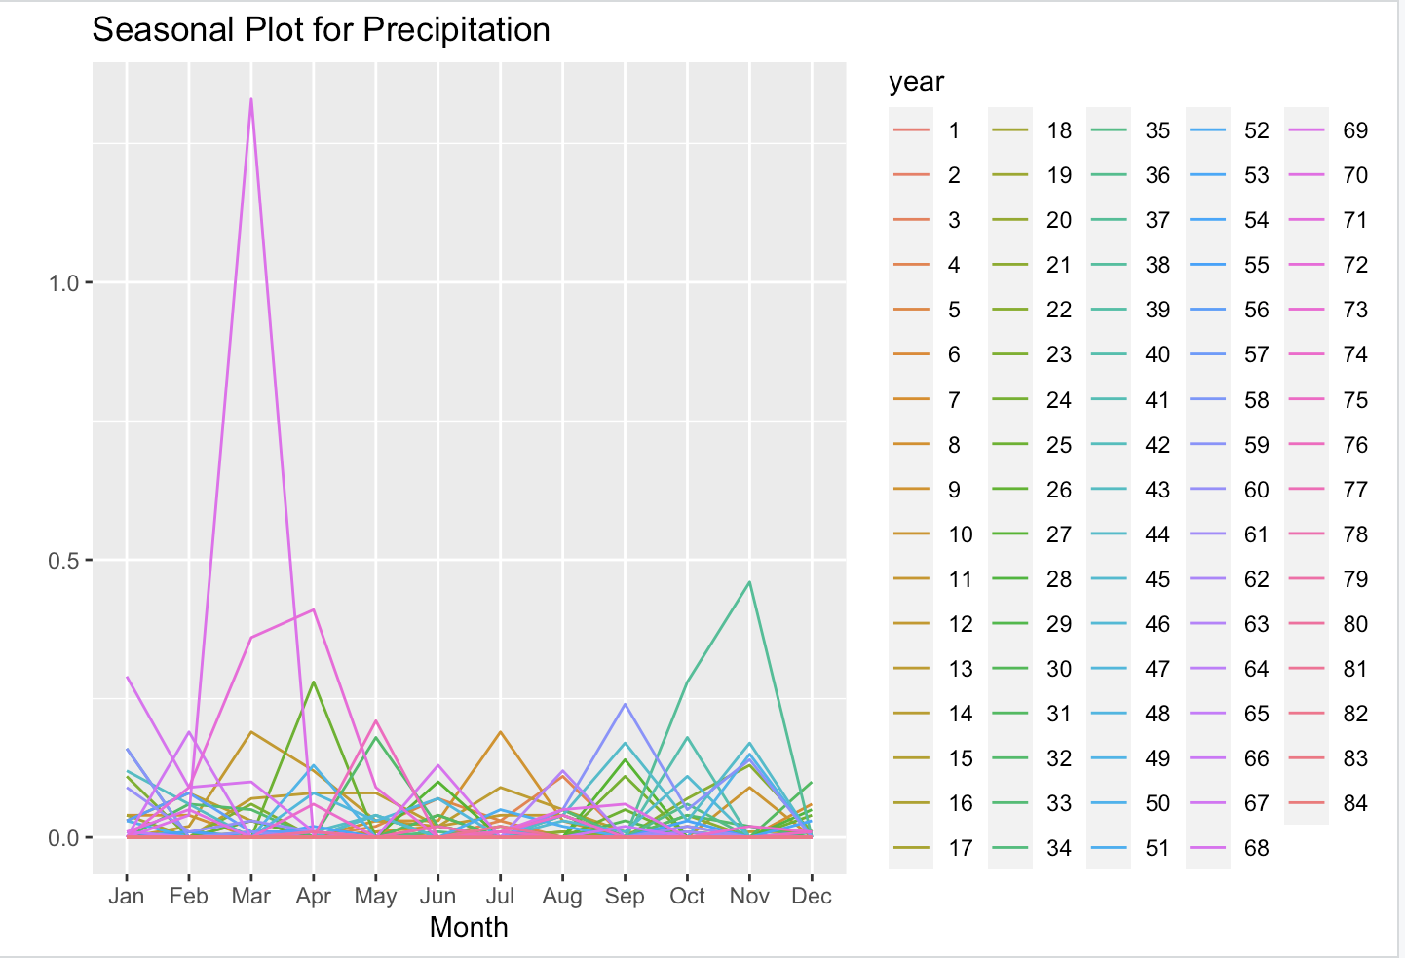
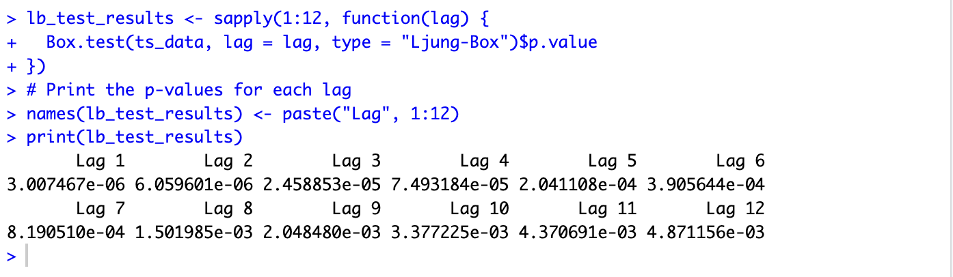
Lag Value Based on P-Value:
Lag value based on p-value:
The lowest p-value is observed for the Lag value 8. So, based on that the Lag value will be 8 according to the p-values calculated using the Ljung-Box test.

Slide 20
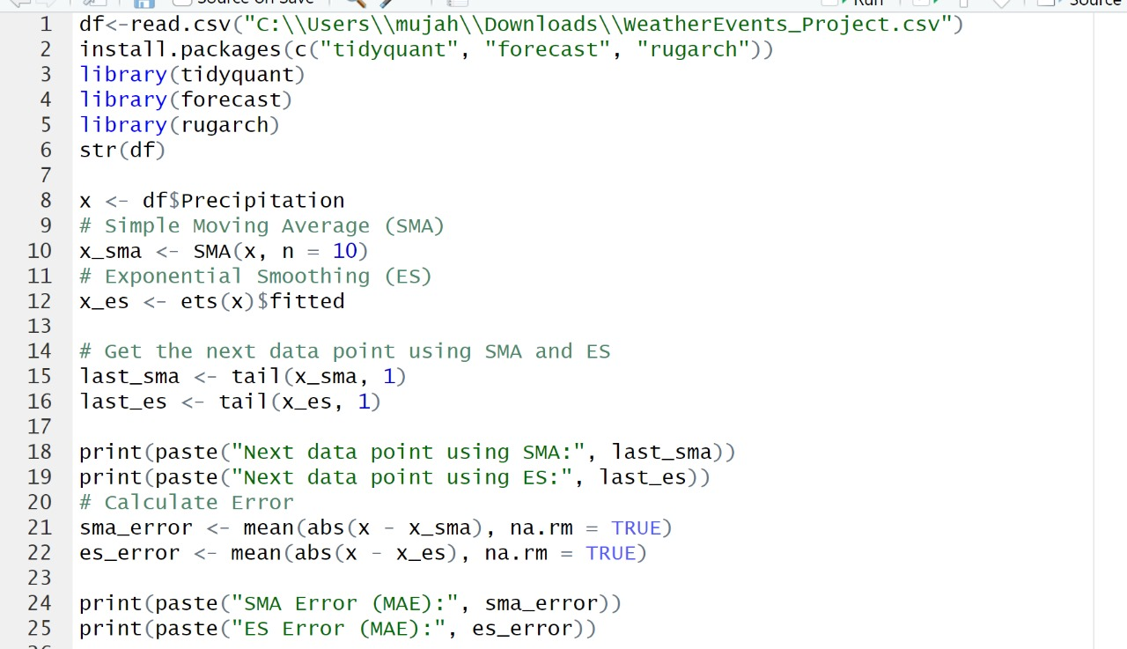
SMA and ES
R code

Slide 21
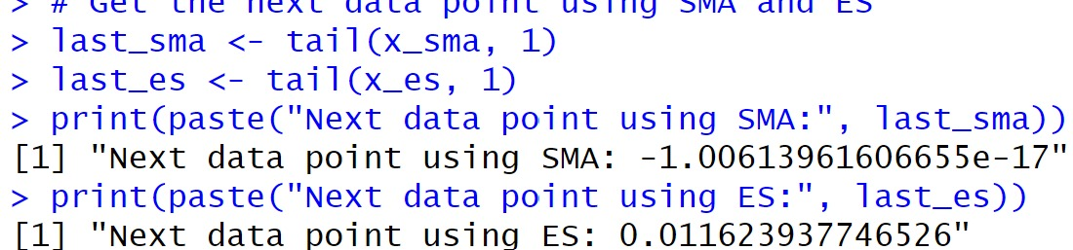
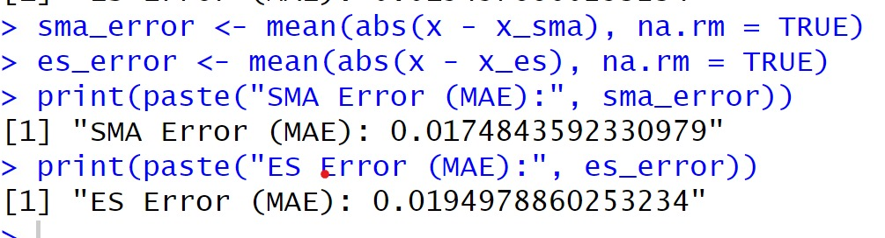
Output
Error

Slide 22
INTERPRETATION
The code computes the Mean Absolute Error (MAE) for forecasts generated using Simple Moving Average (SMA) and Exponential Smoothing (ES) methods. MAE measures the average difference between predicted and actual values, with lower values indicating higher accuracy.
With MAE values of 0.01748436 for SMA and 0.01949789 for ES, the SMA forecast demonstrates slightly better accuracy for the given time series. This suggests that, on average, SMA predictions exhibit smaller deviations from actual values compared to ES forecasts.
Thus, for this dataset, the SMA method may offer marginally superior predictive performance over ES.

Slide 23
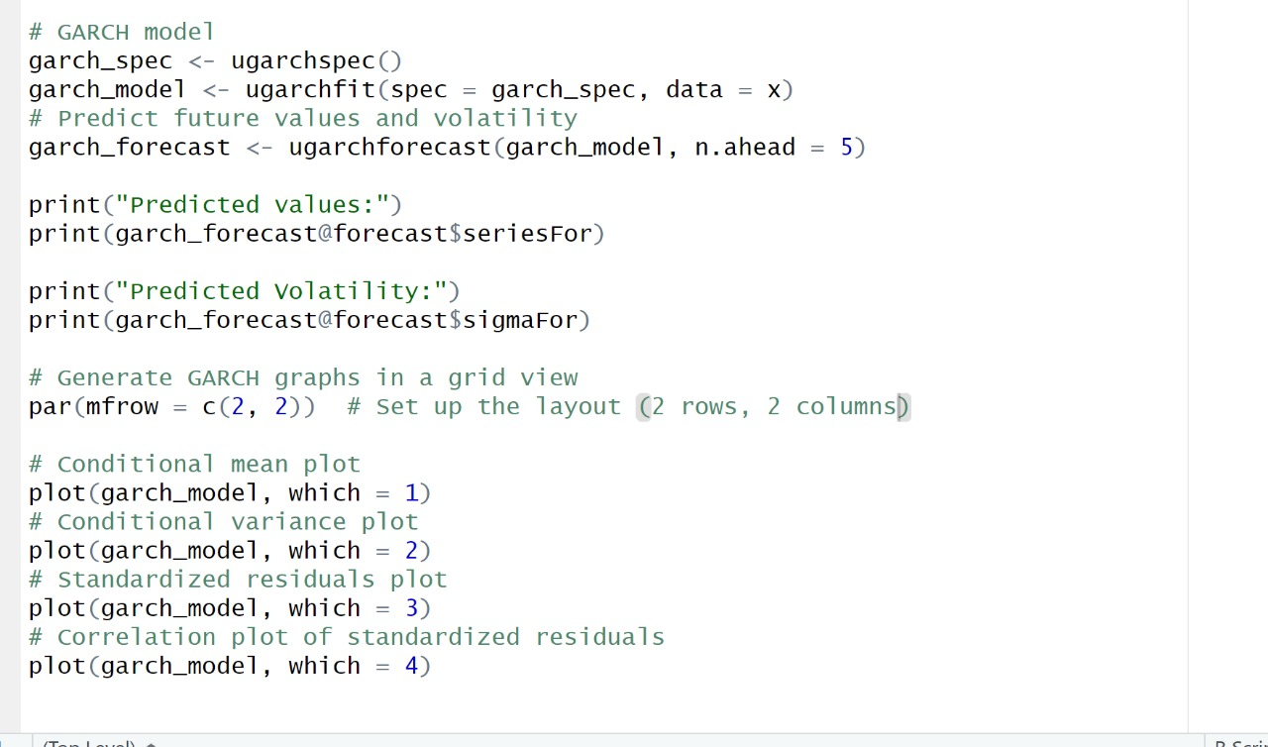
GARCH
R Code

Slide 24
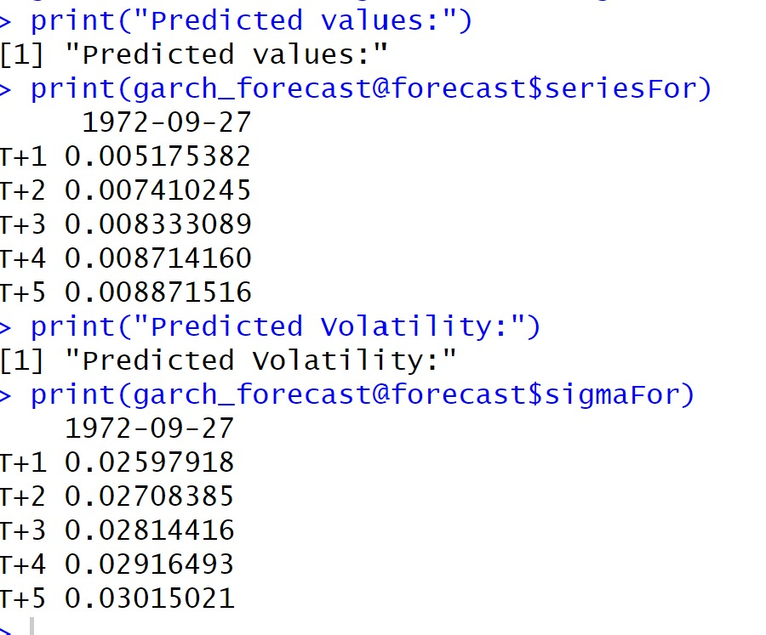
Predicted values

Slide 25
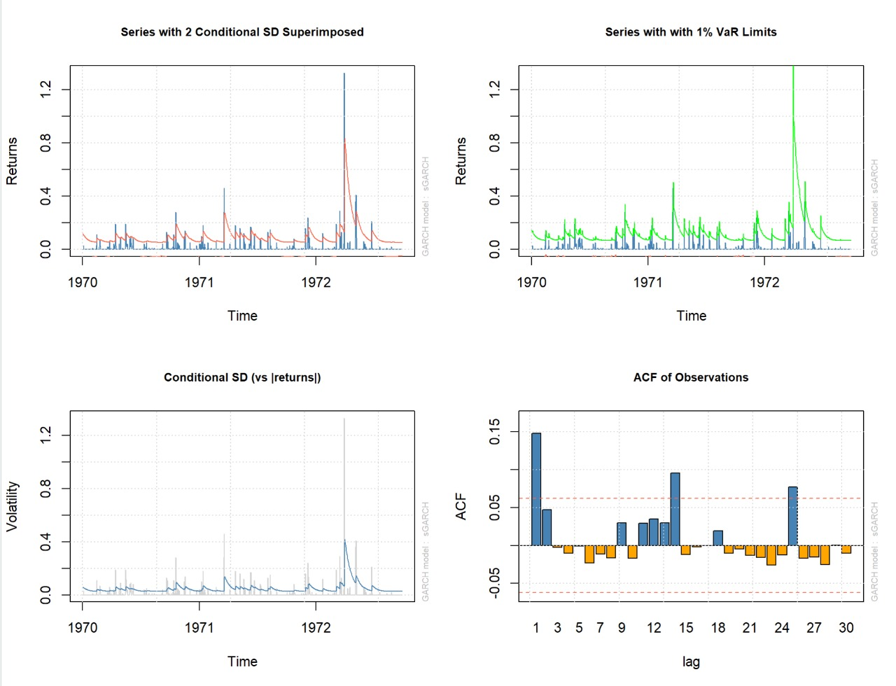
GARCH Graphs

Slide 26
INTERPRETATION
The top left graph suggests that the weather conditions are volatile, with periods of high and low volatility. The two conditional standard deviation bands widen and narrow over time, indicating that the model predicts changes in volatility.
The top right graph suggests that the weather also exhibits a fatter tail than a normal distribution, indicating a higher probability of extreme weather events.
The bottom left graph displays predicted changes in volatility over time.
Lastly, the bottom right graph may suggest serial correlation in weather patterns, implying that past weather conditions could potentially predict future conditions.

Slide 27
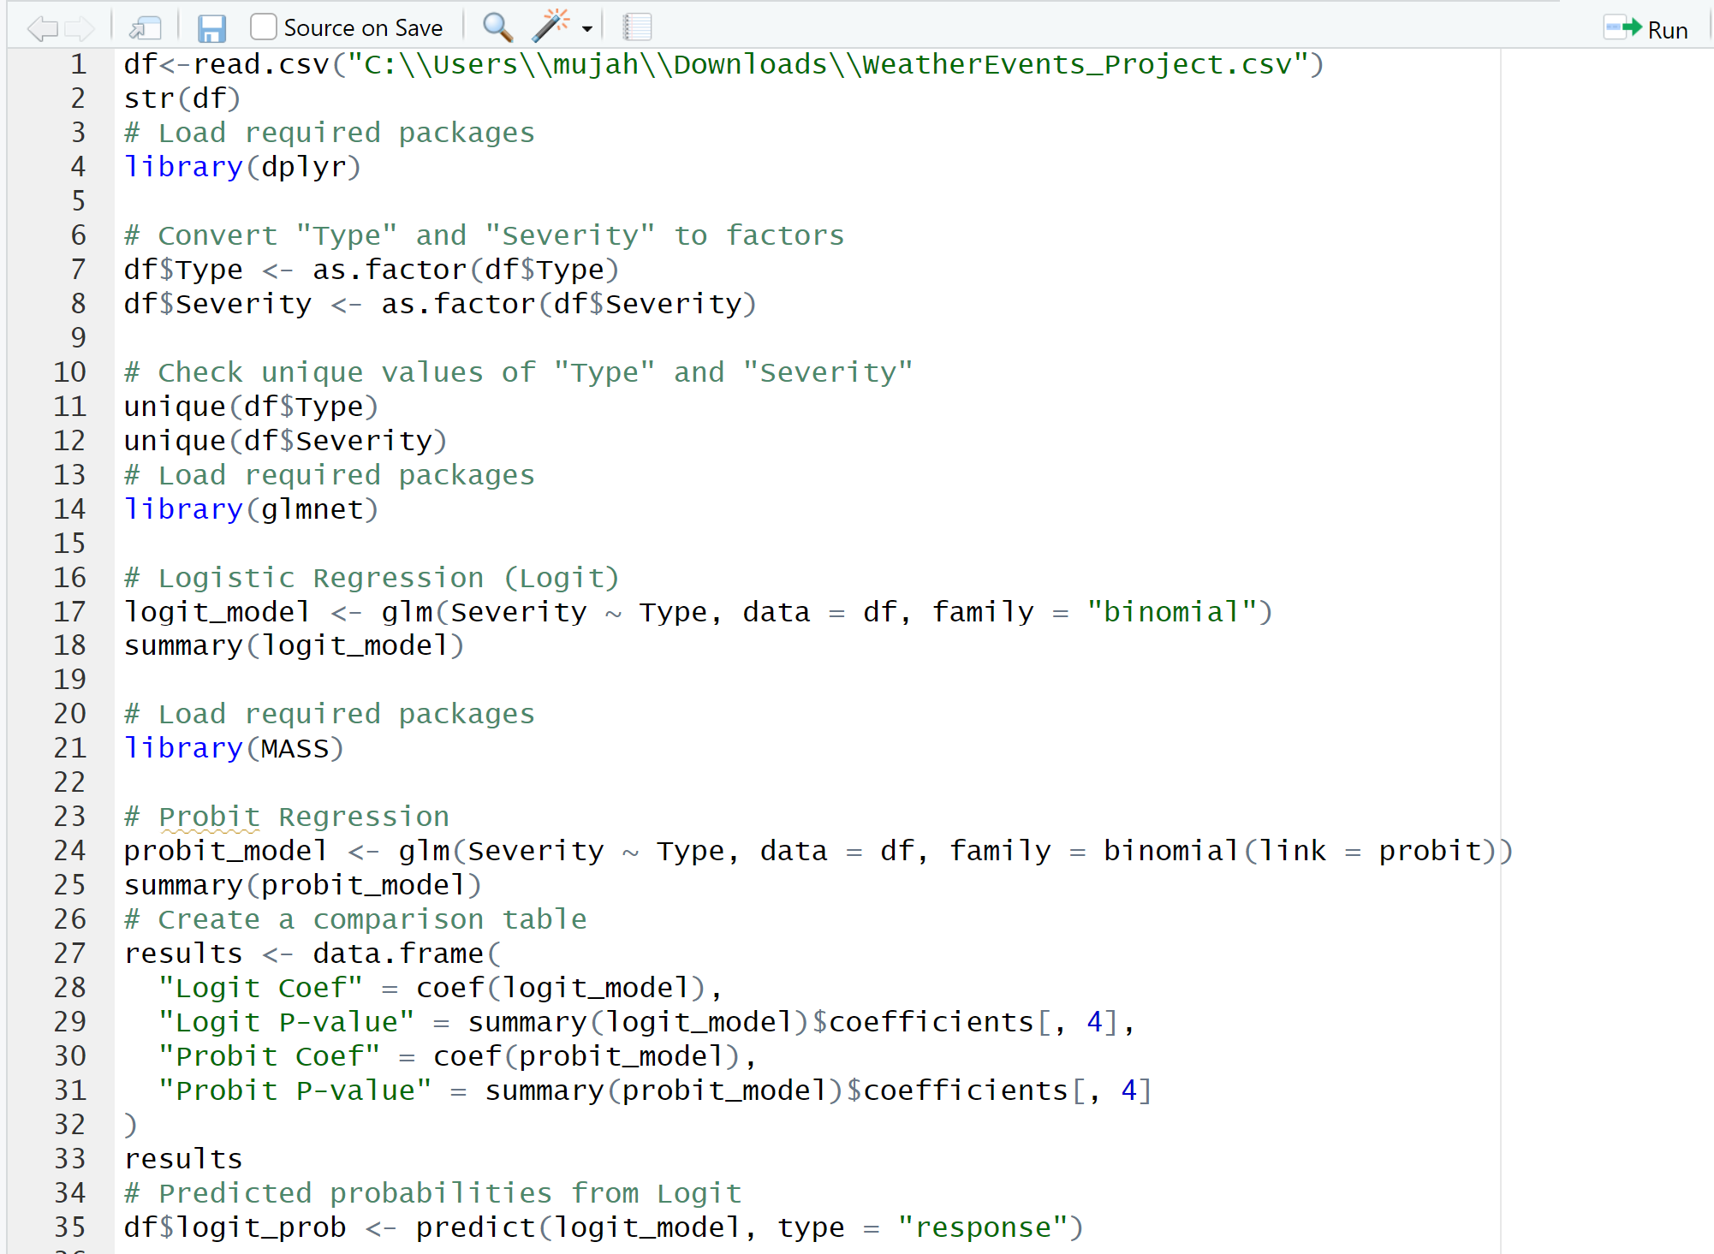
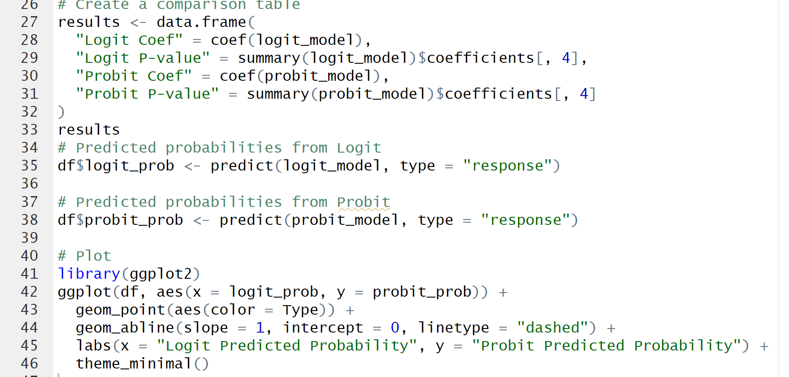
Logit and Probit
Code:

Slide 28
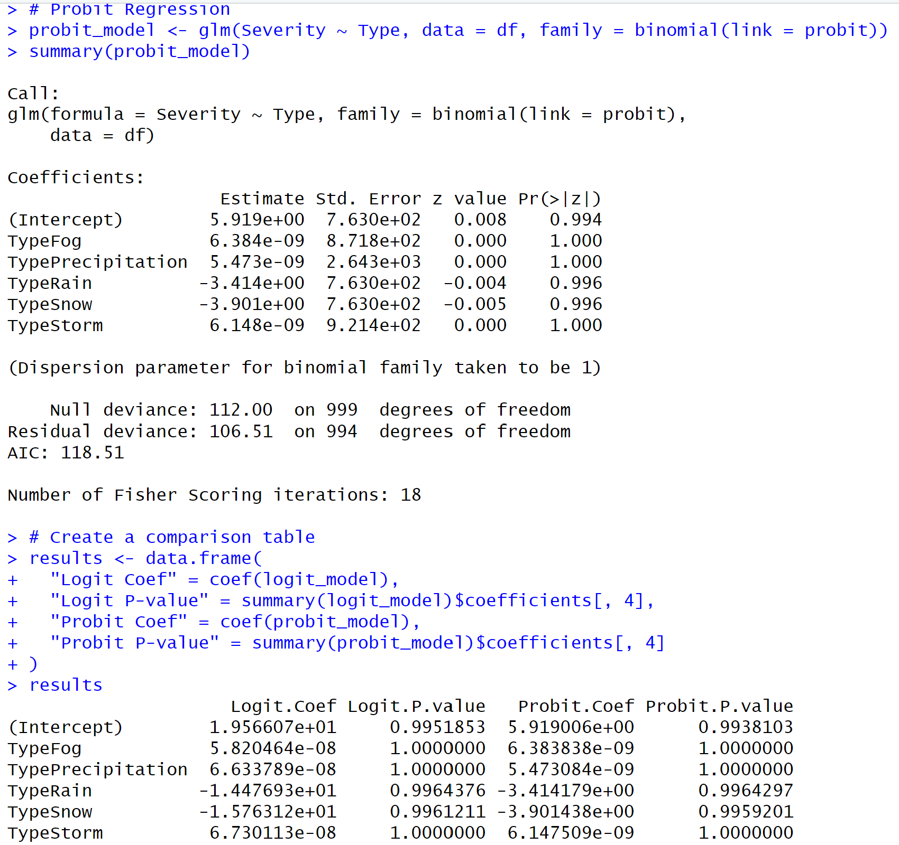
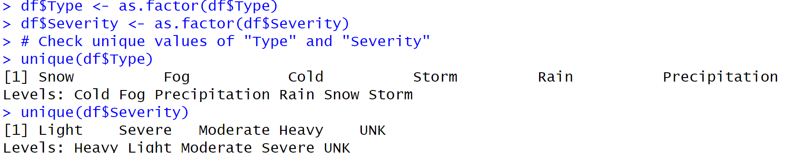
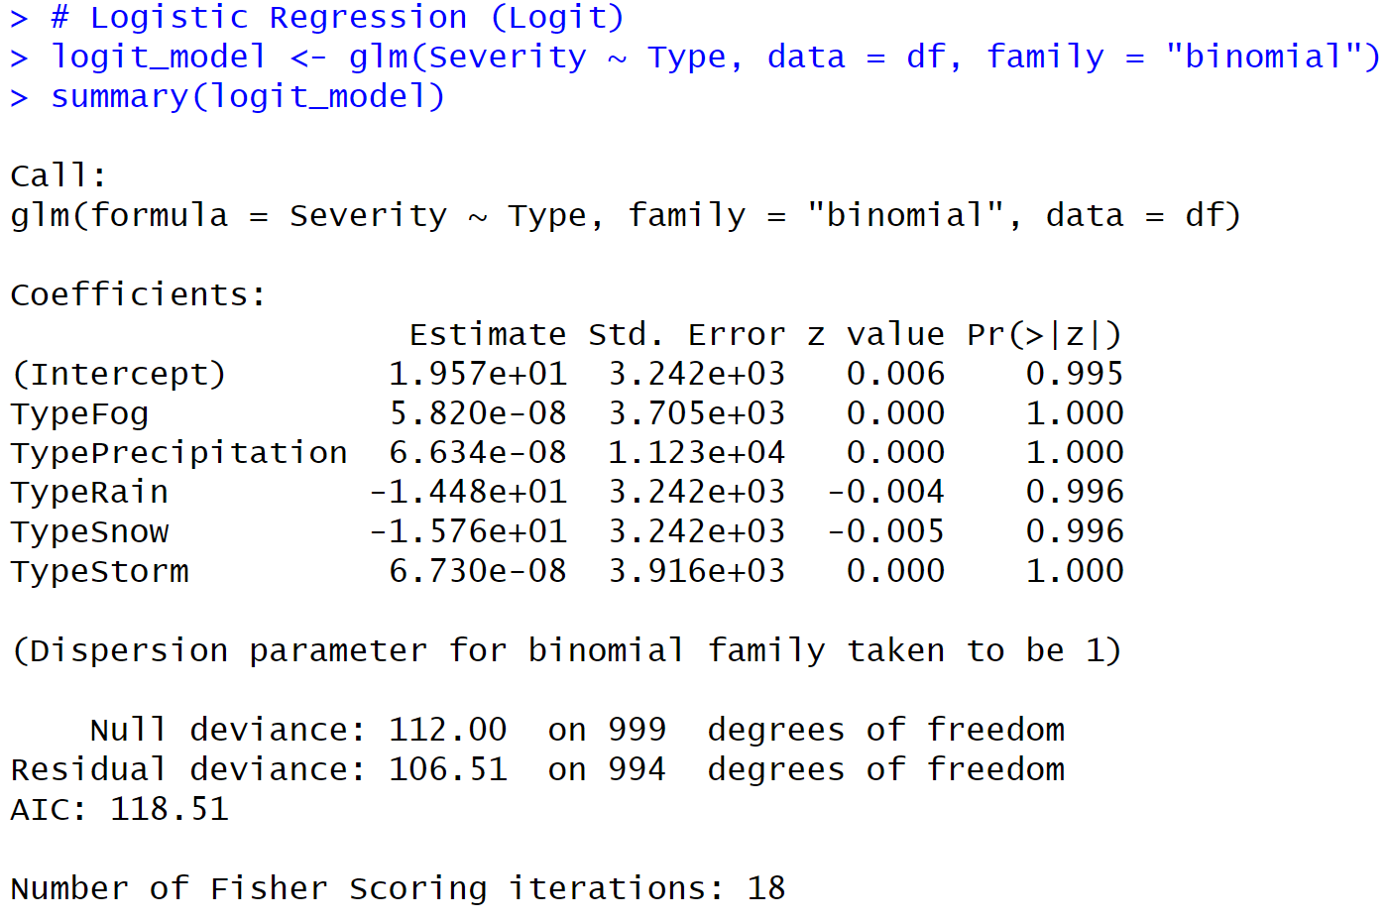
Results

Slide 29
Accuracy and Comparison of Logit and Probit
Logistic Regression (Logit)
Null Deviance: 112.00
Residual Deviance: 106.51
AIC: 118.51
Probit Regression
Null Deviance: 112.00
Residual Deviance: 106.51
AIC: 118.51
Interpretation:
The null deviance represents the model with no predictors (only intercept). In both models, it's the same (112.00).
The residual deviance is the deviance after including predictors. Lower values are better.
Both models have the same residual deviance (106.51), indicating they fit the data equally well.
The AIC is also the same for both models (118.51), suggesting they have similar quality in terms of model fitting.
Conclusion:
Based on the deviance and AIC values:
Both the Logit and Probit models have similar goodness of fit.
They have the same null deviance, residual deviance, and AIC, indicating they perform similarly on this dataset.

Slide 30
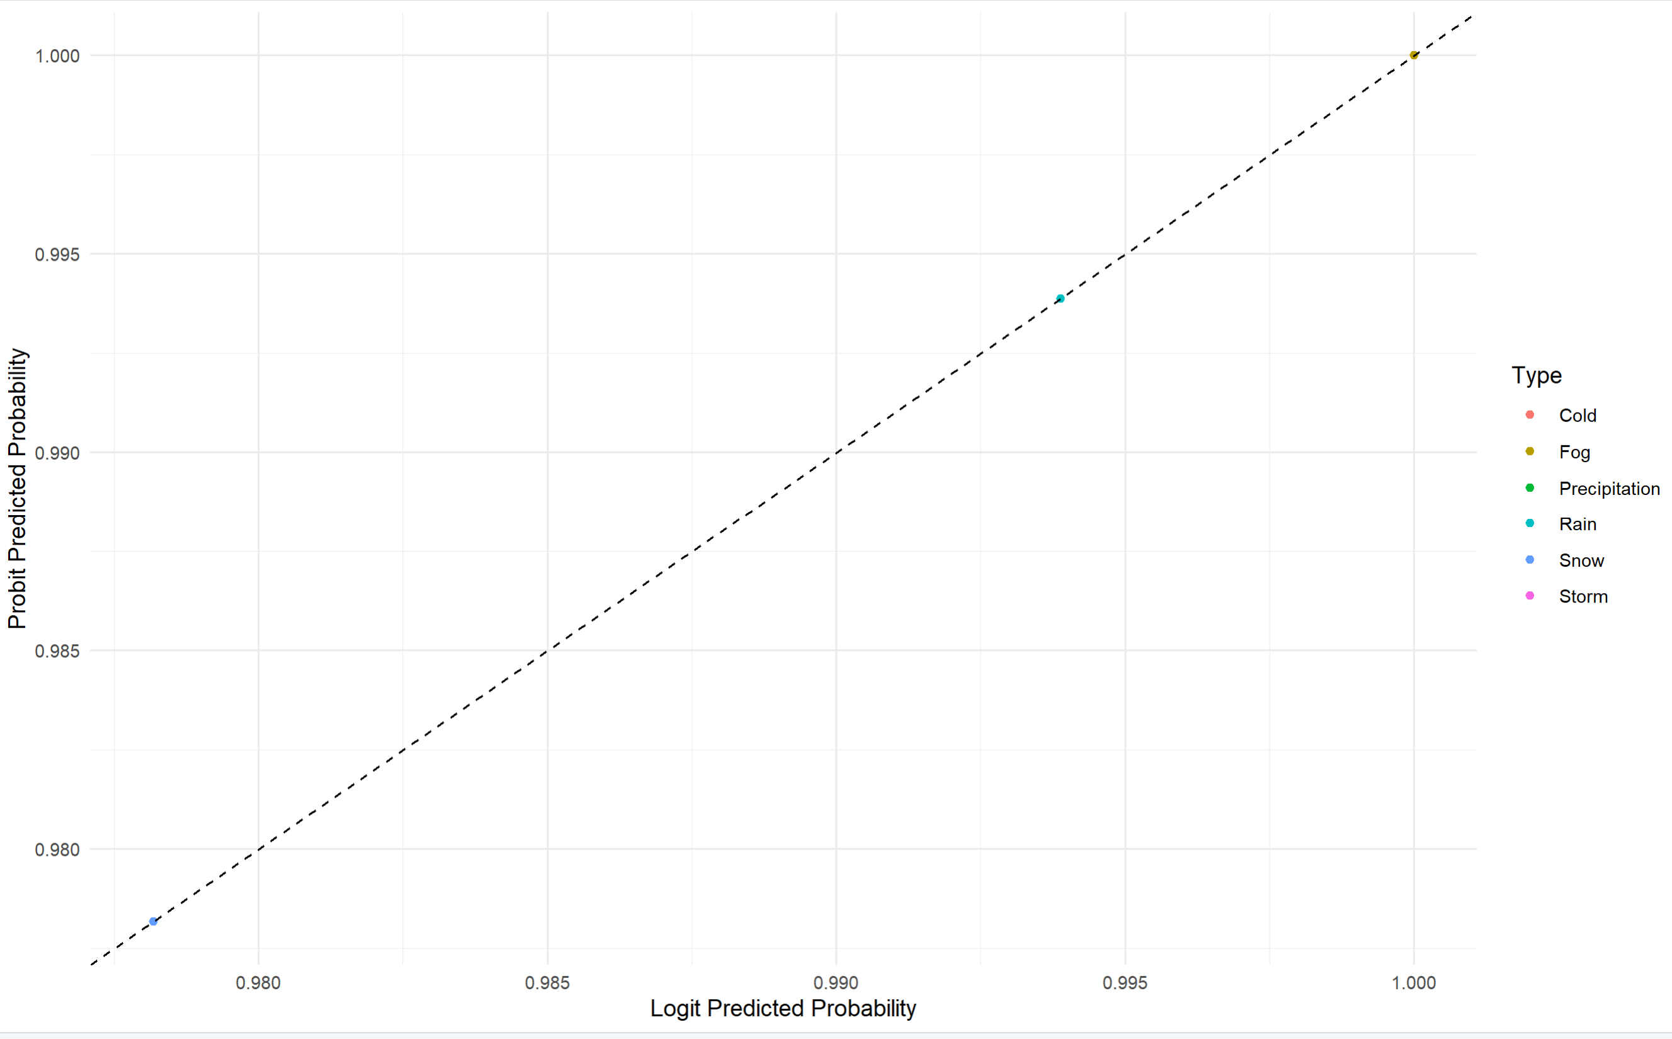
Graph

Slide 31
Interpretation of Graph
The graph displays a calibration curve for a classification model, plotting the model's predicted probabilities (logit or logit predicted probability) on the x-axis against the observed probabilities (probit predicted probability) on the y-axis.
The dashed diagonal line represents perfect calibration, where the predicted probabilities match the observed probabilities.
The different colored dots represent different types or classes in the classification problem, such as "Cold," "Fog," "Precipitation," "Rain," "Snow," and "Storm."
All the colored dots representing the different classes lie exactly on the dashed diagonal line. This indicates that the classification model is perfectly calibrated across all classes or types shown.
When the data points fall precisely on the diagonal line, it means that the predicted probabilities from the model match the observed probabilities or empirical frequencies perfectly. In other words, the model's probability estimates are well-calibrated and aligned with the true underlying probabilities for each class.

Slide 32
Conclusion
The analysis confirmed that both Logit and Probit models are highly effective in forecasting weather conditions, showcasing a strong goodness of fit as indicated by identical deviance and Akaike Information Criterion (AIC) scores. The calibration graph demonstrates that these models accurately predict the probabilities of various weather conditions, aligning perfectly with observed probabilities. This precise calibration across different weather types underscores the reliability of the models in practical applications.
Significant patterns and insights emerged from the data analysis, particularly in understanding the dynamics of precipitation across geographical coordinates. The seasonal analysis revealed a distinct pattern in precipitation trends, increasing in the latter half of the year, which corresponds with historical climate patterns. These findings not only validate the models' effectiveness but also enhance our capability to predict and prepare for seasonal and geographical variations in weather conditions .

Slide 33
Contributions
Chanakya Dandamudi:
Regression Model (with Sai Goutham Chedhella)
Decomposition Graph
Sai Goutham Chedhella:
Data Attributes and Data Description
Regression Model (with Chanakya Dandamudi)
Mounika Bireddy:
Correlation
Lag-Acf Graph
Fnu Sameera Sineen:
Q-Q Plot
Lag of Attribute and Interpretation
Vamshi Nandala:
AutoRegression Equation

Slide 34
References
S. Raksha, J. S. Graceline, J. Anbarasi, M. Prasanna and S. Kamaleshkumar, "Weather Forecasting Framework for Time Series Data using Intelligent Learning Models," 2021 5th International Conference on Electrical, Electronics, Communication, Computer Technologies and Optimization Techniques (ICEECCOT), Mysuru, India, 2021, pp. 783-787, doi: 10.1109/ICEECCOT52851.2021.9707971. keywords: {Analytical models;Machine learning algorithms;Computational modeling;Predictive models;Big Data;Prediction algorithms;Data models;Linear Regression;Logistic Regression;Support Vector Machine;Random Forest Classifier;KNN},
I. Pratama, P. T. Prasetyaningrum and P. Wahyu Setyaningsih, "Time-Series Data Forecasting and Approximation with Smoothing Technique," 2019 International Conference on Information and Communications Technology (ICOIACT), Yogyakarta, Indonesia, 2019, pp. 439-444, doi: 10.1109/ICOIACT46704.2019.8938436. keywords: {Forecasting;Smoothing methods;Extrapolation;Predictive models;Time series analysis;Weather forecasting;Information and communication technology;Forecasting;Time Series;Weather Data;Centroid Decomposition;Savitzky-Golay},

Slide 35
Thank YOu

